Slide 2
Email Safety Awareness Campaign Results

Slide 3
Recap
Over the last month we have been conducting Toolbox talks and disseminating information on email safety to G.James employees.
9th on November we launched the ABOBE simulation, designed to test and educate users on Email Safety.
We decided that the first run would be designed to be easy to detect, this was received well by those who called into service desk.
The Abobe email was a parody of an Adobe email with many spelling mistakes and some very questionable sender information.
On 18th of November we launched the Netflix simulation, with similar inconsistencies than the Abobe simulation. The end user should have realised that Netflix would not be emailing their work email and that the email was generic and not addressed to the user.
Those who clicked the bait hyperlink were taken to a login page.
Those who did so where issued Microsoft training.

Slide 4
Results for ABOBE Simulation
Results for Netflix Simulation
Emails sent 1767.
Emails read 569.
Emails deleted 634.
6% of users that read the email clicked the link.
3% of users that read the email also added their credentials.
52 employees were issued training.
73% have completed training.
27% Have outstanding training.
Emails sent 1777.
Emails read 419.
Emails deleted 702.
4% of users that read the email clicked the link.
0.5% of users that read the email also added their credentials.
16 employees were issued training.
25% have completed training.
75% Have outstanding training.

Slide 5
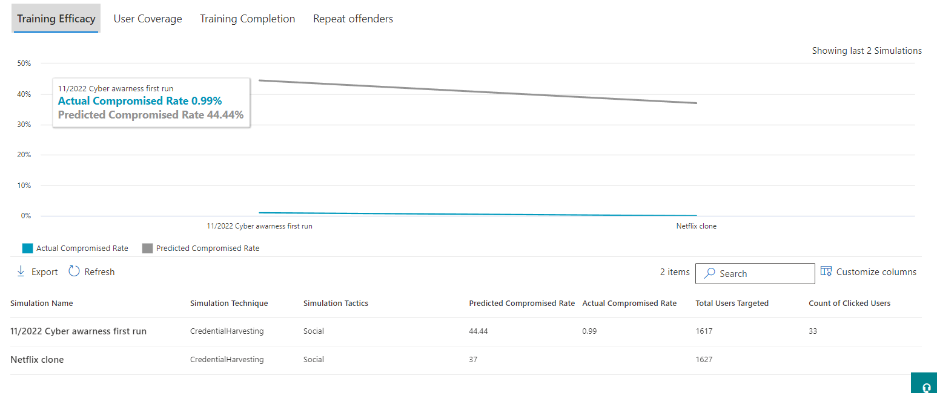
Cumulative results vs Expected results
Microsoft predicted that the catch rate for these simulations would be approximately 44%, actual compromised rate was only 1%.
These emails where designed to be easy, and many shared accounts where included in the distribution.

Slide 6
Moving Forward
For December we plan to release two emails with fictitious malware attachments.
These emails should be harder to detect for the end user.
End users should be able to use what has been covered in the first two and spot the inconsistencies.
End users have been instructed in how to treat executables on emails, in the toolboxes that have been conducted.

